Slide 1
Lecture #8
SOFT COMPUTING
INT508

Slide 2
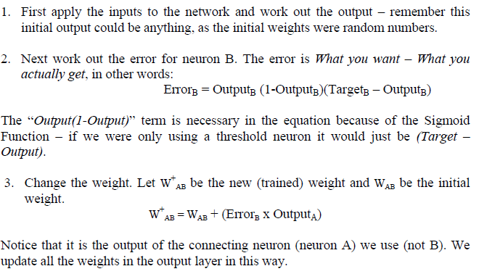
Back propagation Algorithm

Slide 3
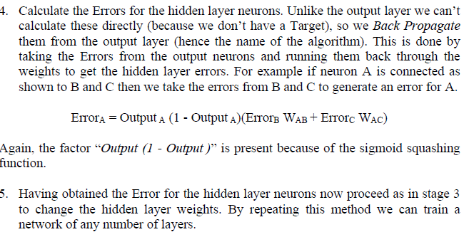
Back propagation Algorithm

Slide 4
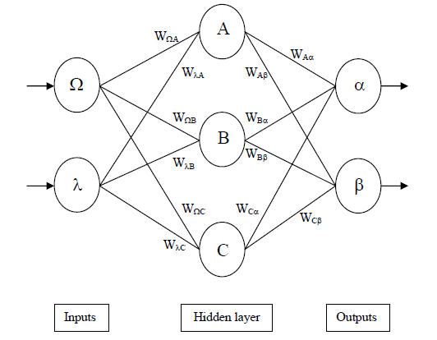
Back propagation Algorithm

Slide 5
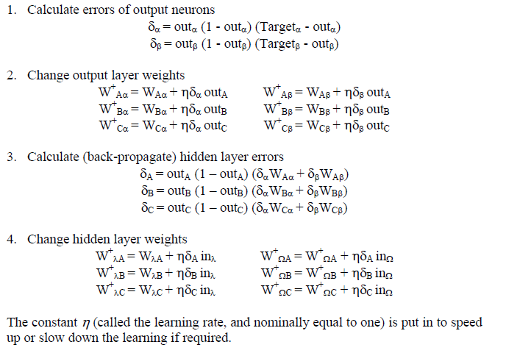
Back propagation Algorithm

Slide 6
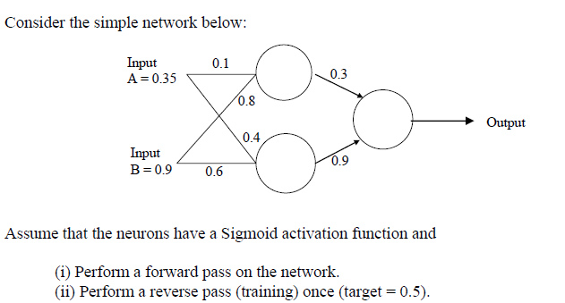
Back propagation Algorithm

Slide 7
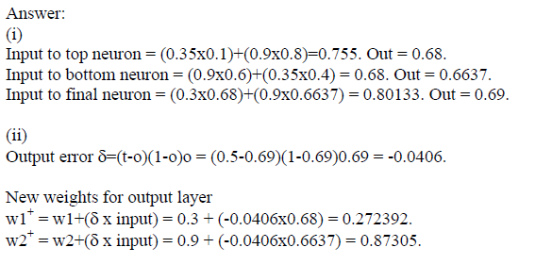
Back propagation Algorithm

Slide 8
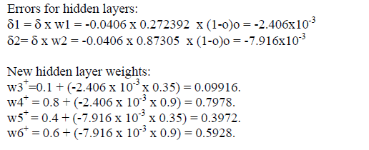
Back propagation Algorithm

Slide 9
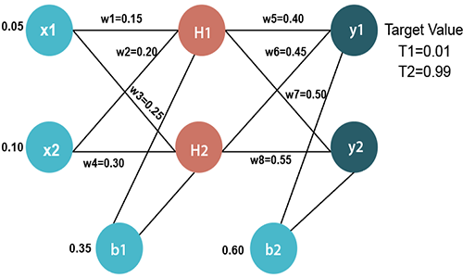
Example

Slide 10
Input values
X1=0.05 X2=0.10
Initial weight
W1=0.15 w5=0.40
W2=0.20 w6=0.45
W3=0.25 w7=0.50
W4=0.30 w8=0.55
Bias Values
b1=0.35 b2=0.60
Target Values
T1=0.01 T2=0.99

Slide 11
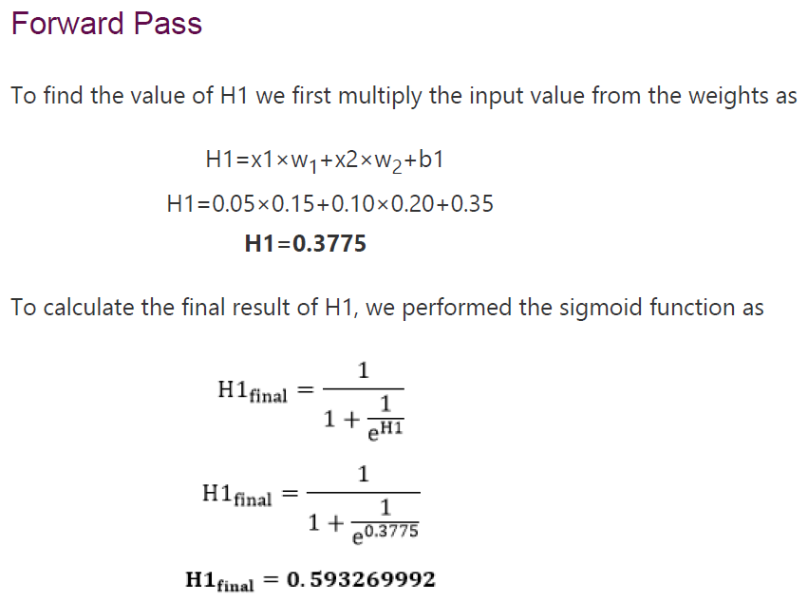

Slide 12


Slide 13
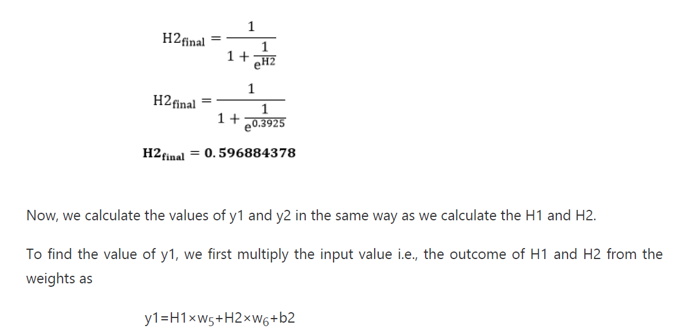

Slide 14
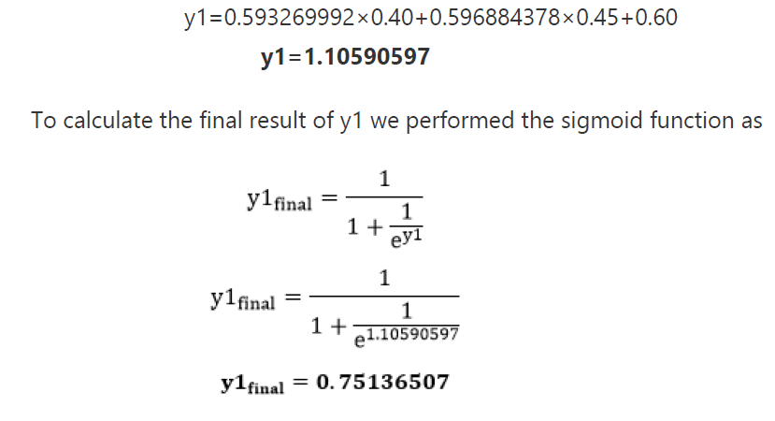

Slide 15
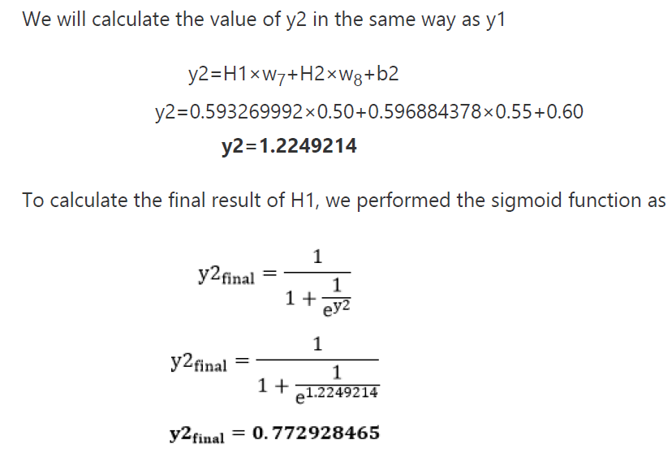

Slide 16
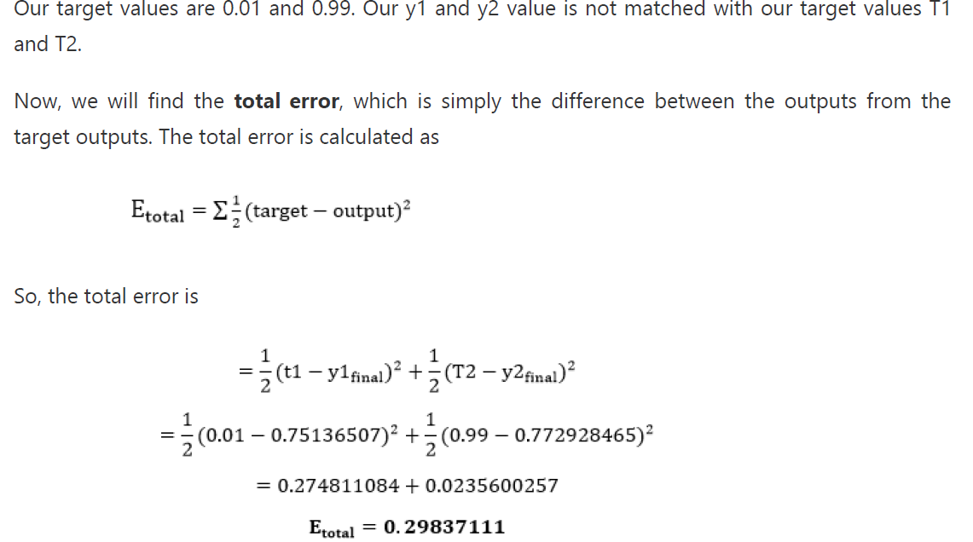

Slide 17
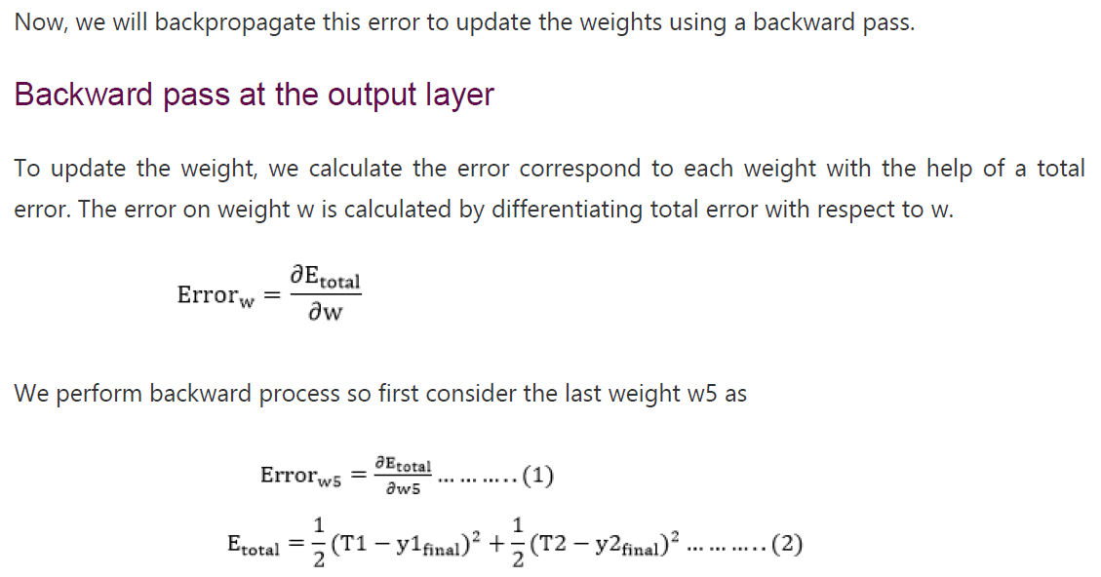

Slide 18

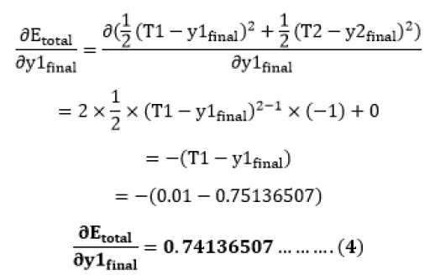

Slide 19
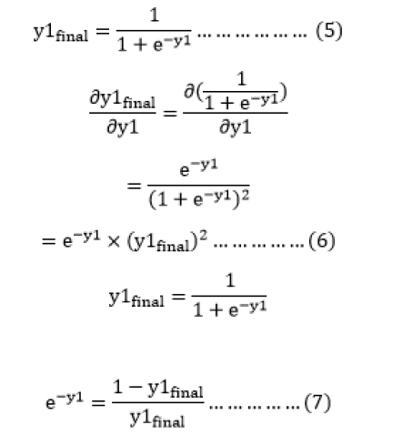

Slide 20
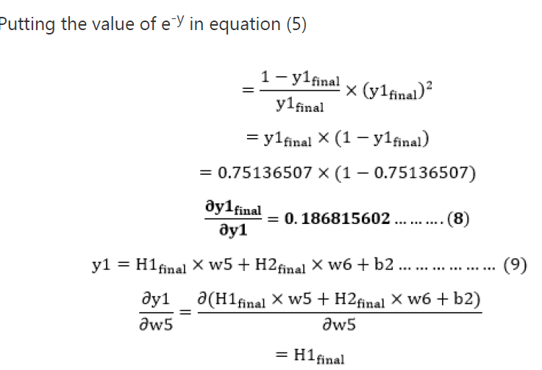

Slide 21



Slide 22
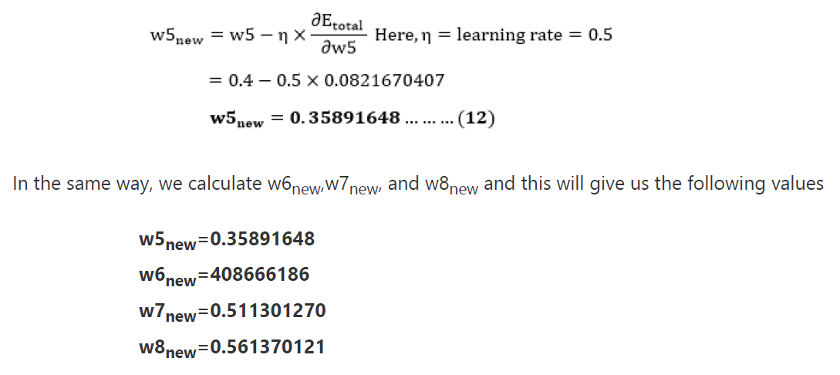

Slide 23
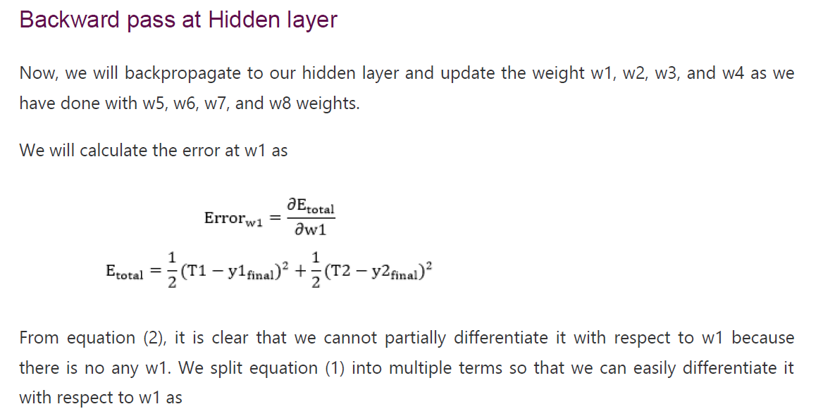

Slide 24

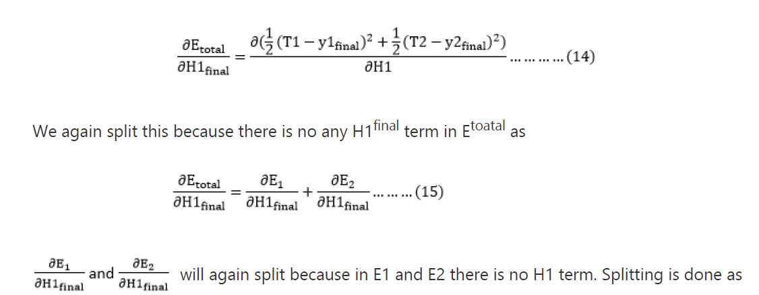

Slide 25
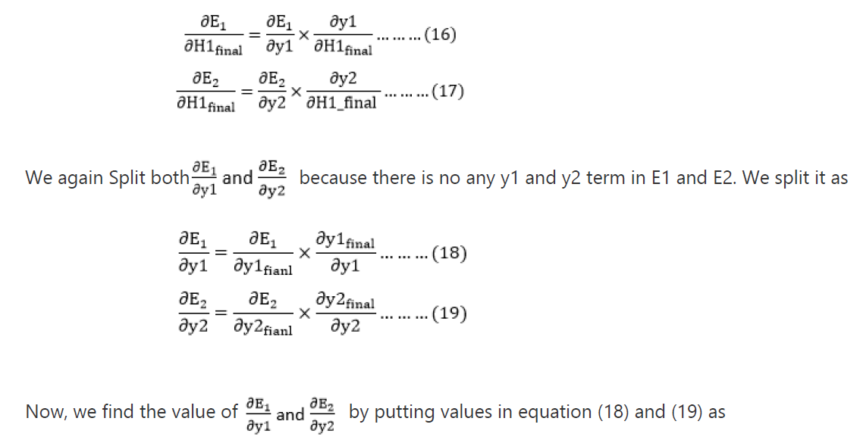

Slide 26
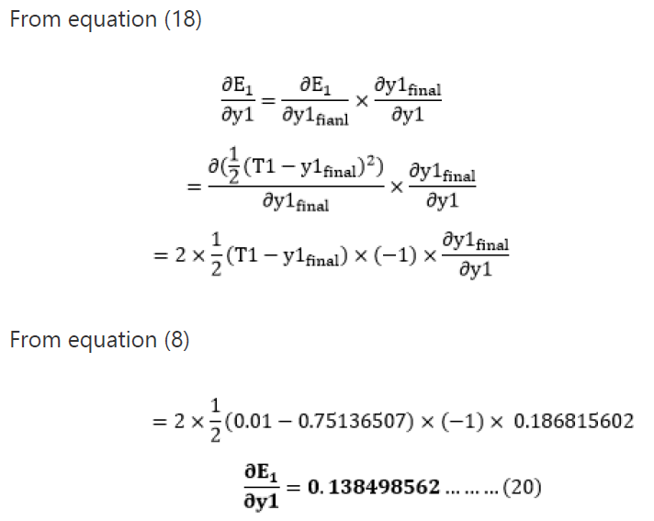

Slide 27
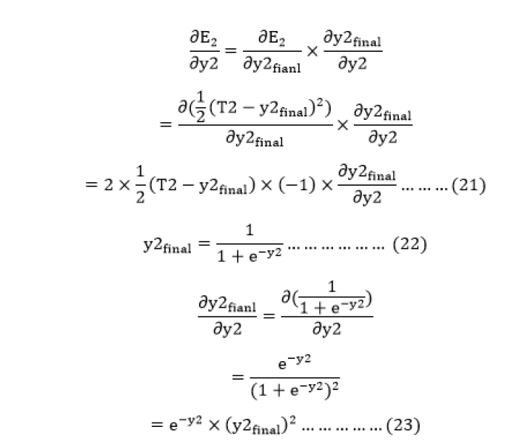

Slide 28
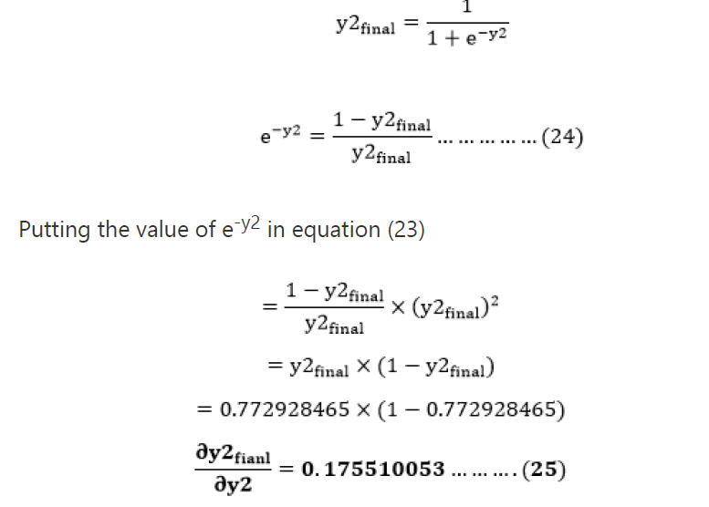

Slide 29
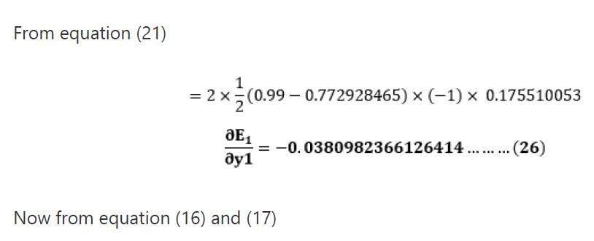

Slide 30
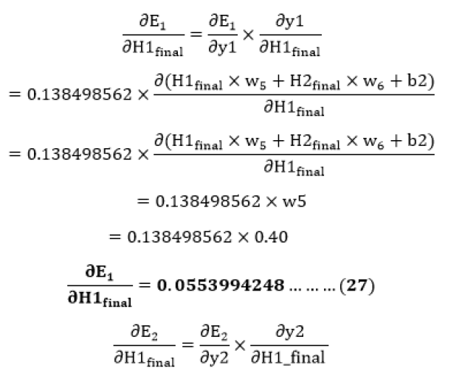

Slide 31
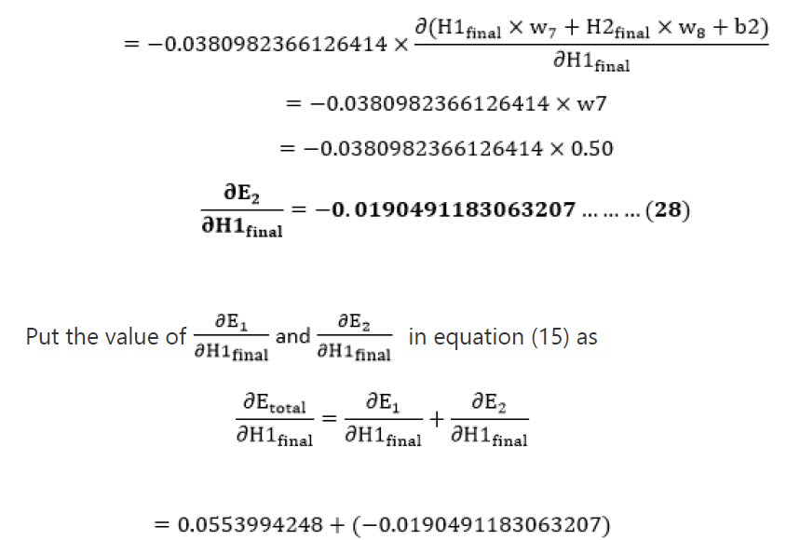

Slide 32

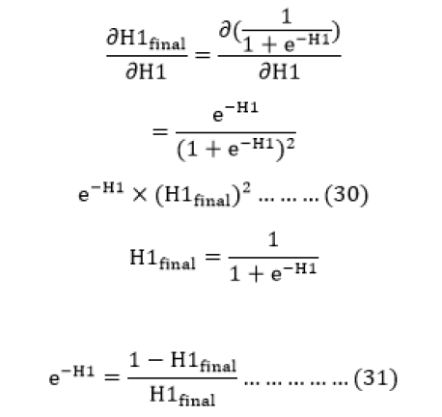

Slide 33
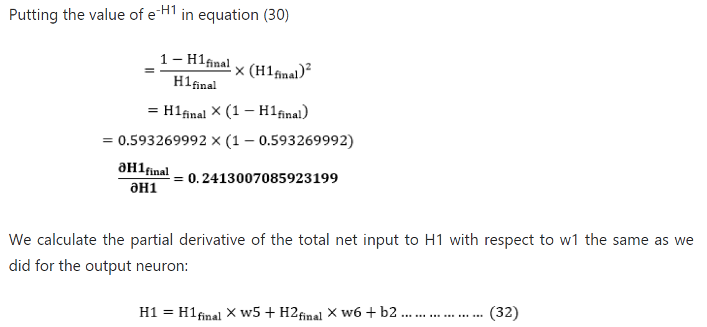

Slide 34
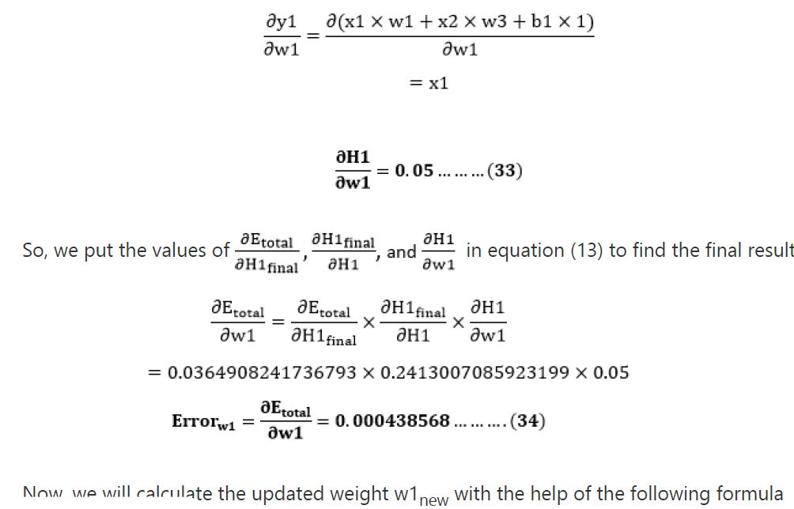

Slide 35
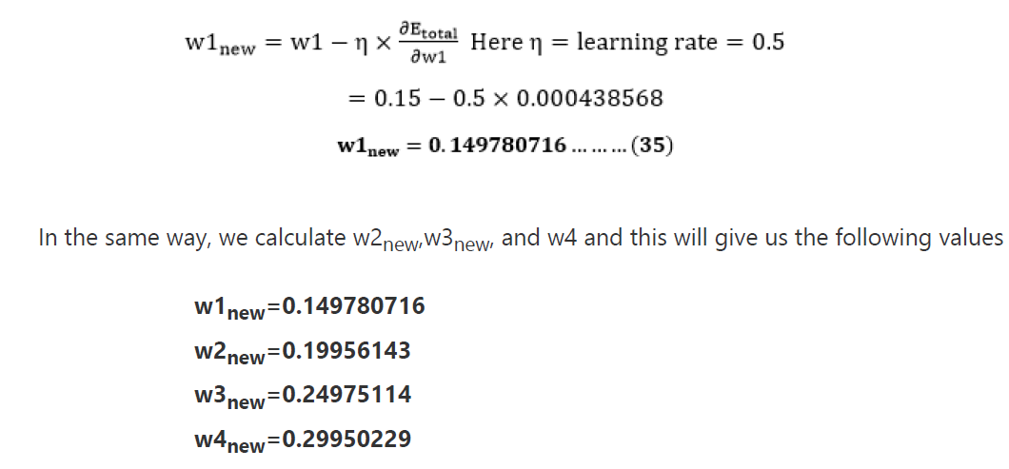

Slide 36


Slide 37
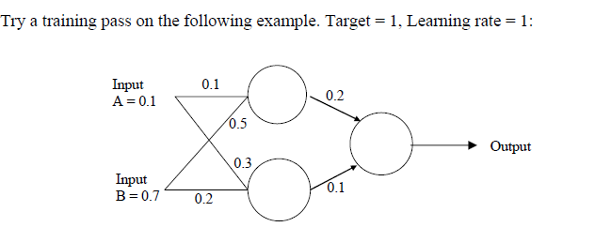
Assignment

Slide 38

12/12/14
CSE510, Lovely Professional University, Phagwara

